Slide 1
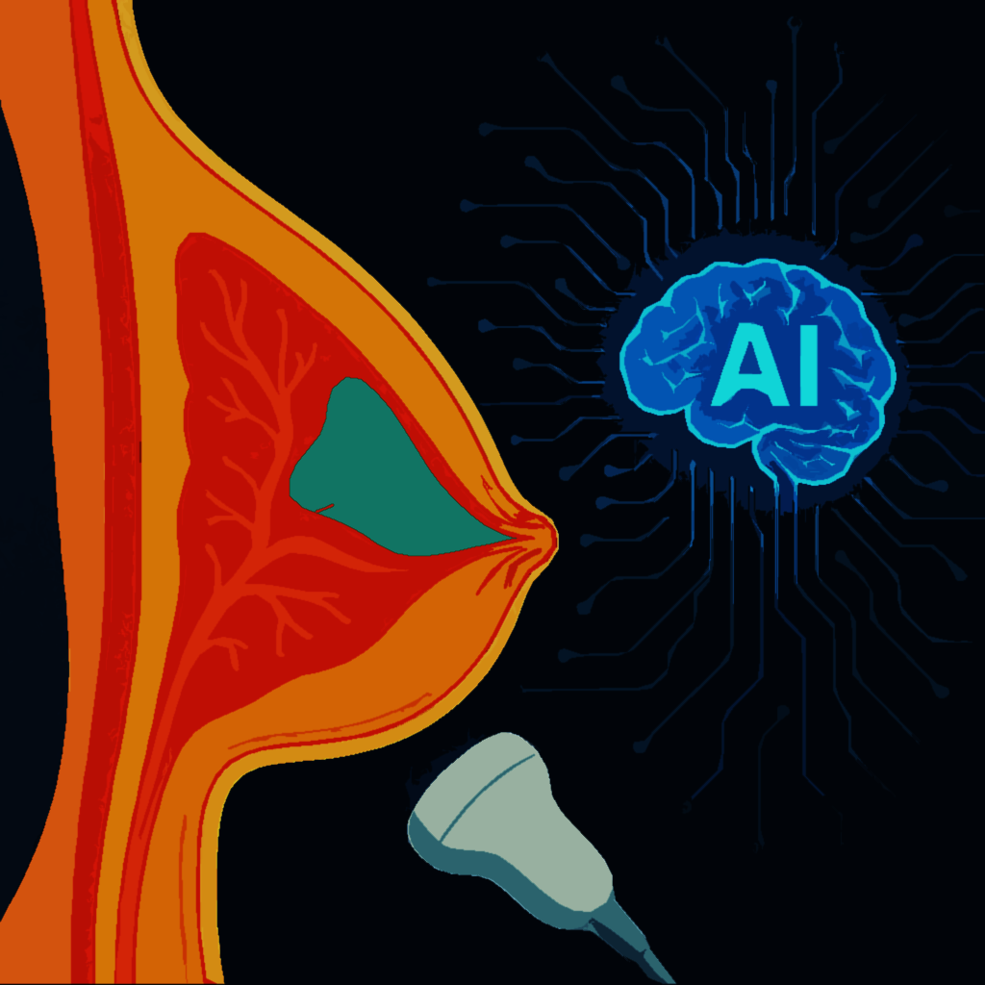
EXPLORING DEEP LEARNING AI ULTRASOUND AS A PRIMARY BREAST CANCER SCREENING TOOL
By
Frederick Damptey
&
Benjamin Odoom Asomaning

Slide 2
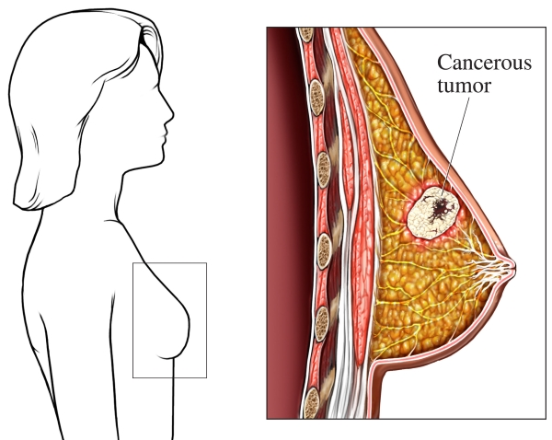
Overview
Breast cancer is caused by malignant cell growth in breast tissue. Breast cancer is the second most common cancer and leading cause of cancer deaths in American women. It mainly affects women; men account for only 0.5–1% of cases.
The global burden is significant: In developed countries, 1 in 12 women are at risk. In developing countries, 1 in 27 women are at risk.
In the U.S., 1 in 8 women (13%) are at lifetime risk (American Cancer Society, 2025).
Mortality is higher in underdeveloped countries (2.1%) than in developed countries (1.4%) – (WHO, 2022).
Standard screening includes clinical breast exams and mammography, with mammography is the gold standard screening test.
It is readily accessible and affordable in high-income countries (HICs), but in low- and middle-income countries (LMICs), accessibility is limited.
Ultrasound scan (USS) on the other hand is more common in LMICs and comparatively more affordable, portable and has high diagnostic accuracy.

Slide 3
Literature Review
Study | Method | Findings
Hanis et al (2022) | Metanalysis of 36 studies containing 68 machine learning models. | The study found a promising potential to support ML use in mammography for breast cancer detection.
Hickman et al (2021) | Systematic review and metanalysis of 15 studies on the use of standalone and triaged ML models. | The study found a comparable performance of stand-alone or human-augmented mammography ML models compared to human readers.
Li et al (2024) | Systematic review and metanalysis of 20 USS ML models for breast cancer detection. | ML model-integrated multi-modal breast imaging yields a superior accuracy for breast cancer detection.
Miglioretti et at (2015) | A study of the performance of 486 Radiologists to update established mammography evaluation thresholds. | Reviewed and published updated acceptable clinical diagnostic performance values for mammography in breast cancer detection
Wang et al (2022) | Individual study comparing the efficacy of ultrasound and mammography in breast cancer detection. | Found that ultrasound is accurate at detecting breast cancer. However, more research is required.
Ahmed et al (2019) | Trained USS image dataset on their CNN, pretrained and finetuned CNN models to perform breast cancer classification task, and evaluated their results against fine-tuned MM and MR CNN models. | Finetuned pretrained USS CNN models had the best performance and presented promising prospect for USS AI for breast cancer detection.

Slide 4
Problem Statement & Aim of Study
Problem
Breast cancer is a leading cause of cancer mortality among women worldwide, particularly in LMICs, where access to mammography is often limited. USS, though cost-effective and widely available, is understudied and underutilized due to concerns over diagnostic efficacy, hampering its use as a standard screening tool.
Aim
To develop an effective CNN deep learning model and determine whether deep learning AI can enhance the diagnostic performance of ultrasound for breast cancer detection and justify its use as an alternative to mammography in screening.

Slide 5
Study Significance
An USS AI model that can predict breast cancer earlier with high accuracy is essential in reducing breast cancer deaths, especially in LMICs.
We believe that a better AI predictive model could potentially inform policy changes in screening, by allowing adoption of USS as an acceptable breast cancer screening tool.
Our project will contribute to the growing evidence in support of leveraging informatics to better prevent diseases and improve the health of women worldwide.

Slide 6
Methodology
Dataset acquisition: One labeled dataset containing 780 breast ultrasound (USS) images was sourced from Kaggle by the name, “Dataset_BUSI_with_GT”. The dataset is divided into three folders based on class labels: normal, benign and malignant.
Four pretrained CNN deep learning models were adapted for our image classification task – ResNet50, EfficientNet, InceptionV3 and VGG16.
Modelling Process: Loading dataset, resizing, image conversion, normalization, splitting dataset, importing and adapting pretrained models, training and prediction.
The best of the models was selected based on performance evaluation (i.e. accuracy, sensitivity, specificity and AUROC).
Confusion matrix and AUROC were also plotted to visualize performance.

Slide 7
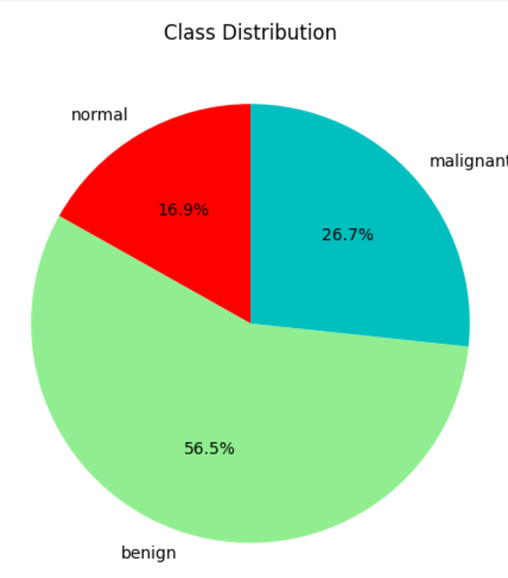
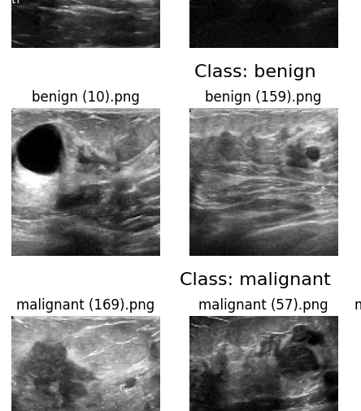
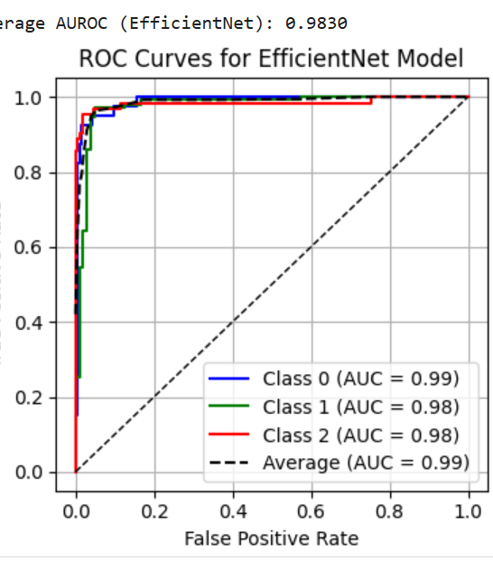
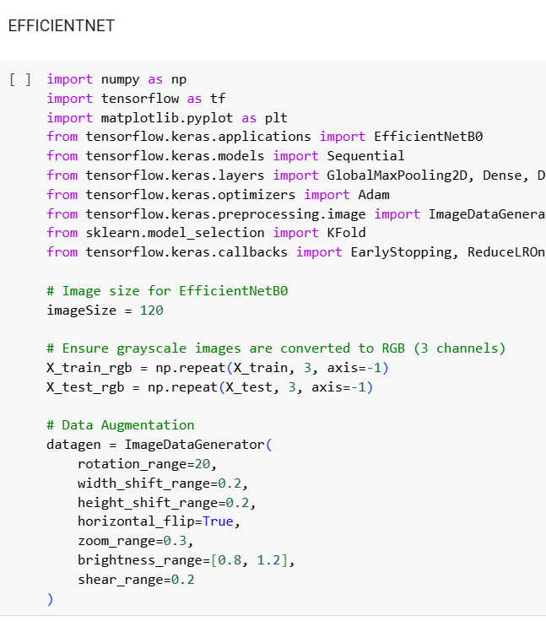
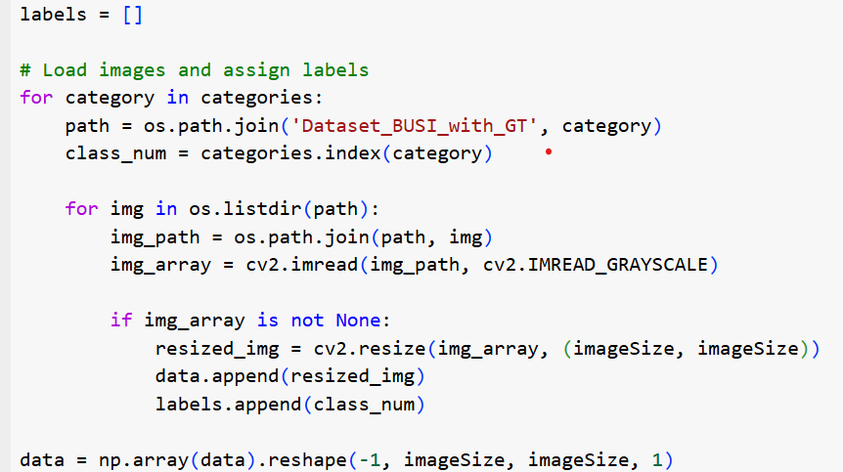
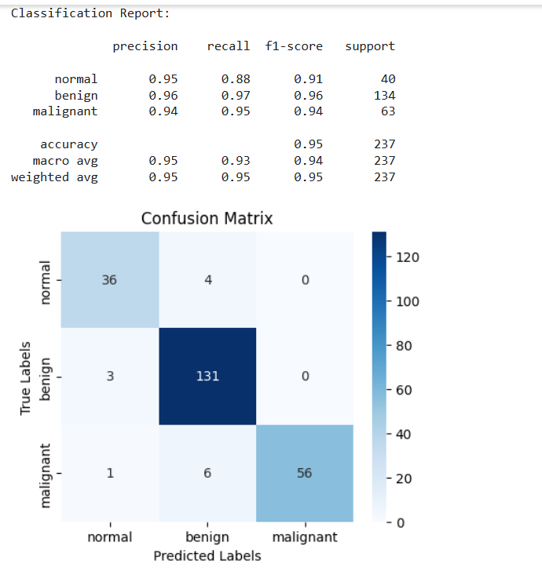
Code Snippets

Slide 8
Results

Slide 9
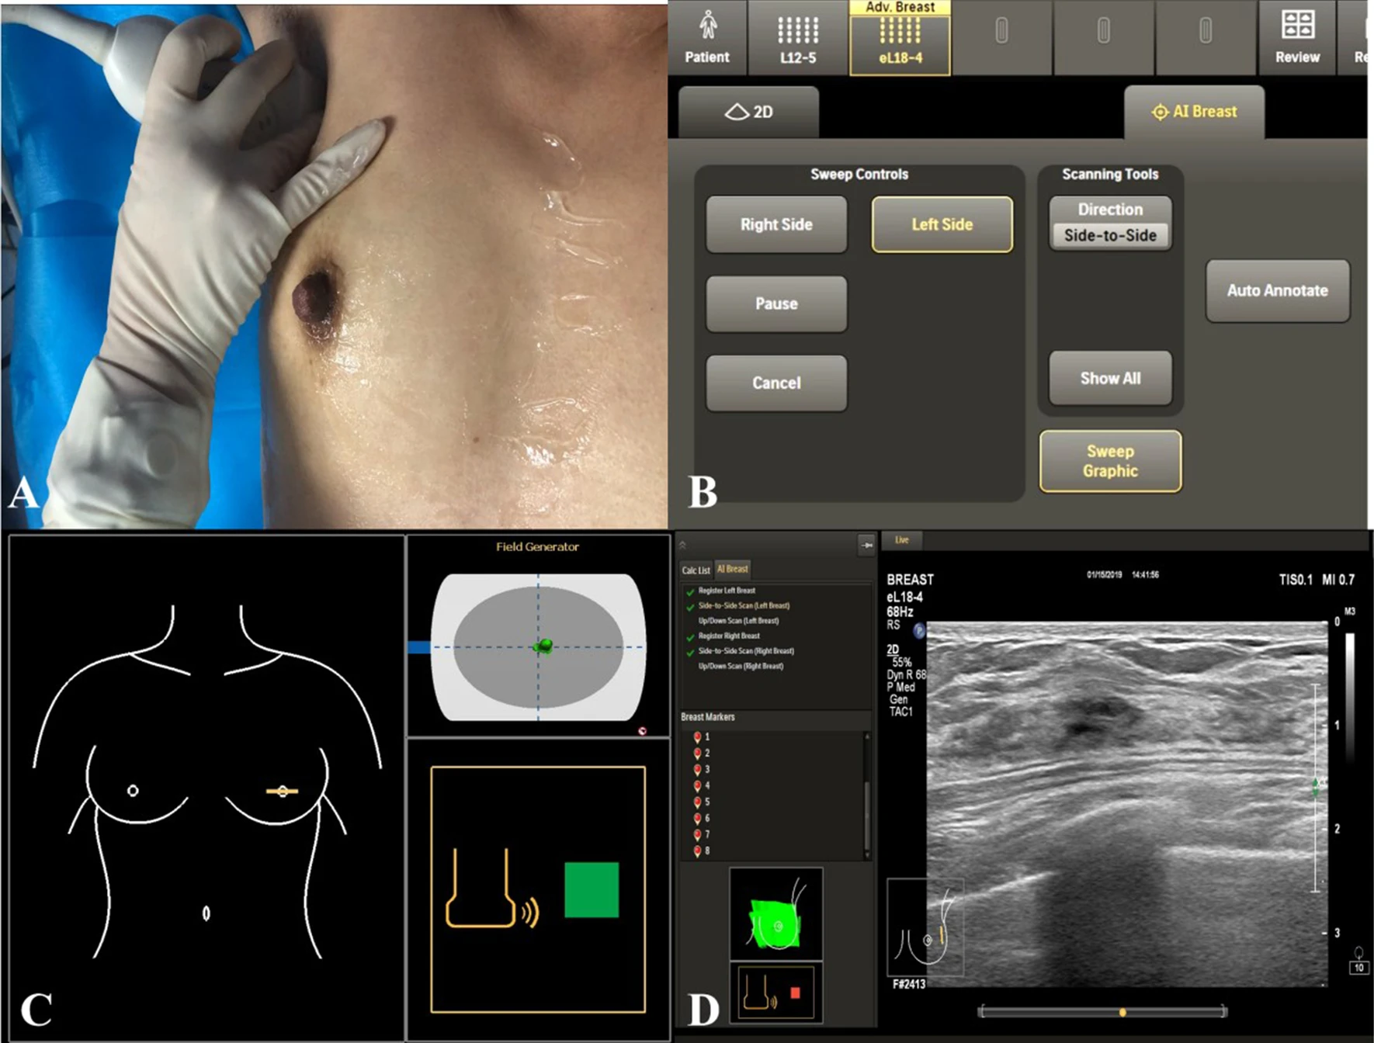
Discussion
Comparative Evaluation of Our Model Performance against Models
 | AUC | Sensitivity | Specificity
Against Ultrasound ML Models
Our Model | 0.99 | 0.933 | 0.97
Li et al (2024) | 0.732 | 0.93 | 0.9
Against Mammography ML models
Our USS Model | 0.927 | 0.933 | 0.97
Hanis et al (2022) | 0.9 | 0.83 | 0.873
Hickman et al (2021) | 0.89 | 0.754 | 0.906
Against Human Readers
Our Model | 0.99 | 0.933 | 0.97
Miglioretti et al (2015)Mammography thresholds |  | ≥0.75 | ≥0.88
Hickman et al (2021) | 0.85 | 0.73 | 0.886

Slide 10
Discussion

Slide 11
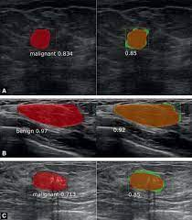
Conclusion
Our projects concludes that ultrasound AI, particularly deep learning models, whether used as standalone or human-assisted has a superior or comparable diagnostic performance to mammography.
Its diagnostic performance surpasses human readers, making it a highly promising tool for primary breast cancer screening in resource-constrained areas.
Therefore, a closer look at the technology and policies regarding its usage is essential, as it has the potential to enable earlier breast cancer detection, which will ultimately reduce related mortality rate, healthcare costs and overall disease burden.

Slide 12
Limitations & Recommendations
Limitations
Small dataset size hampers post study generalization.
Limited computational resource for a very robust modeling process.
Time constraints hindered rigorous literature review.
Future Work and Recommendations
Further develop our model with a larger dataset to improve performance and allow generalization.
Perform a rigorous meta-analytic systematic reviews, especially on recent studies to reflect current advancements.
We recommend that there should be a careful assessment of global and national policies on breast cancer screening programs to inform possible adoption of USS AI as a primary screening tool.

Slide 13
References
American Cancer Society. (2025). Breast cancer. https://www.cancer.org/cancer/types/breast-cancer.html
Hanis, T. M., Islam, M. A., & Musa, K. I. (2022). Diagnostic accuracy of machine learning models on mammography in breast cancer classification: A meta-analysis. Diagnostics (Basel), 12(7), 1643. https://doi.org/10.3390/diagnostics12071643 (Link: PMC)
Hickman, S. E., Woitek, R., Le, E. P. V., Im, Y. R., Luxhøj, C. M., Aviles-Rivero, A. I., Baxter, G. C., MacKay, J. W., & Gilbert, F. J. (2021). Machine learning for workflow applications in screening mammography: Systematic review and meta-analysis. Radiology. https://doi.org/10.1148/radiol.2021210391 (Link: RSNA)
Li, H., Zhao, J., & Jiang, Z. (2024). Deep learning-based computer-aided detection of ultrasound in breast cancer diagnosis: A systematic review and meta-analysis. Clinical Radiology, 79(11), e1403-e1413. https://doi.org/10.1016/j.crad.2024.08.002 (Link: ScienceDirect)
Miglioretti, D. L., Ichikawa, L., Smith, R. A., Bassett, L. W., Feig, S. A., Monsees, B., Parikh, J. R., Rosenberg, R. D., Sickles, E. A., & Carney, P. A. (2015). Criteria for identifying radiologists with acceptable screening mammography interpretive performance on basis of multiple performance measures. AJR American Journal of Roentgenology, 204(4), W486–W491. https://doi.org/10.2214/AJR.13.12313
Wang, Y., Li, Y., Song, Y., Chen, C., Wang, Z., Li, L., Liu, M., Liu, G., Xu, Y., Zhou, Y., Sun, Q., & Shen, S. (2022). Comparison of ultrasound and mammography for early diagnosis of breast cancer among Chinese women with suspected breast lesions: A prospective trial. Thoracic Cancer, 13(22), 3145–3151. https://doi.org/10.1111/1759-7714.14666
World Health Organization. (2024). Breast cancer: Fact sheet. https://www.who.int/news-room/fact-sheets/detail/breast-cancer
Xue, P., Wang, J., Qin, D., & et al. (2022). Deep learning in image-based breast and cervical cancer detection: A systematic review and meta-analysis. npj Digital Medicine, 5(19). https://doi.org/10.1038/s41746-022-00559-z (Link: Nature)
Hijab, A., Rushdi, M. A., Gomaa, M. M., & Eldeib, A. (2019, October 17–19). Breast cancer classification in ultrasound images using transfer learning (pp. 1–4). In Proceedings of the 2019 Fifth International Conference on Advances in Biomedical Engineering (ICABME), Tripoli, Lebanon. https://doi.org/10.1109/ICABME47164.2019.8940266

Slide 14

THANK YOU

